Slide 1
Assessing ELLs Not Performing at Grade Level
Mariyah Adamji
Tasha Frank
Jordyn Hugill

Slide 2
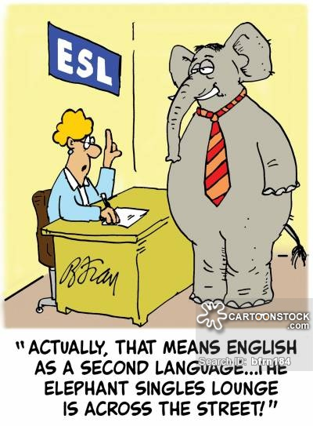

Slide 3

Outline
Before Assessment
Key Principles
Listening Strategies
Speaking Strategies
Reading Strategies
Writing Strategies
Conclusion
Notes:
This is just rough so we can change it up as we see fit. Same with the background and whatever else!

Slide 4
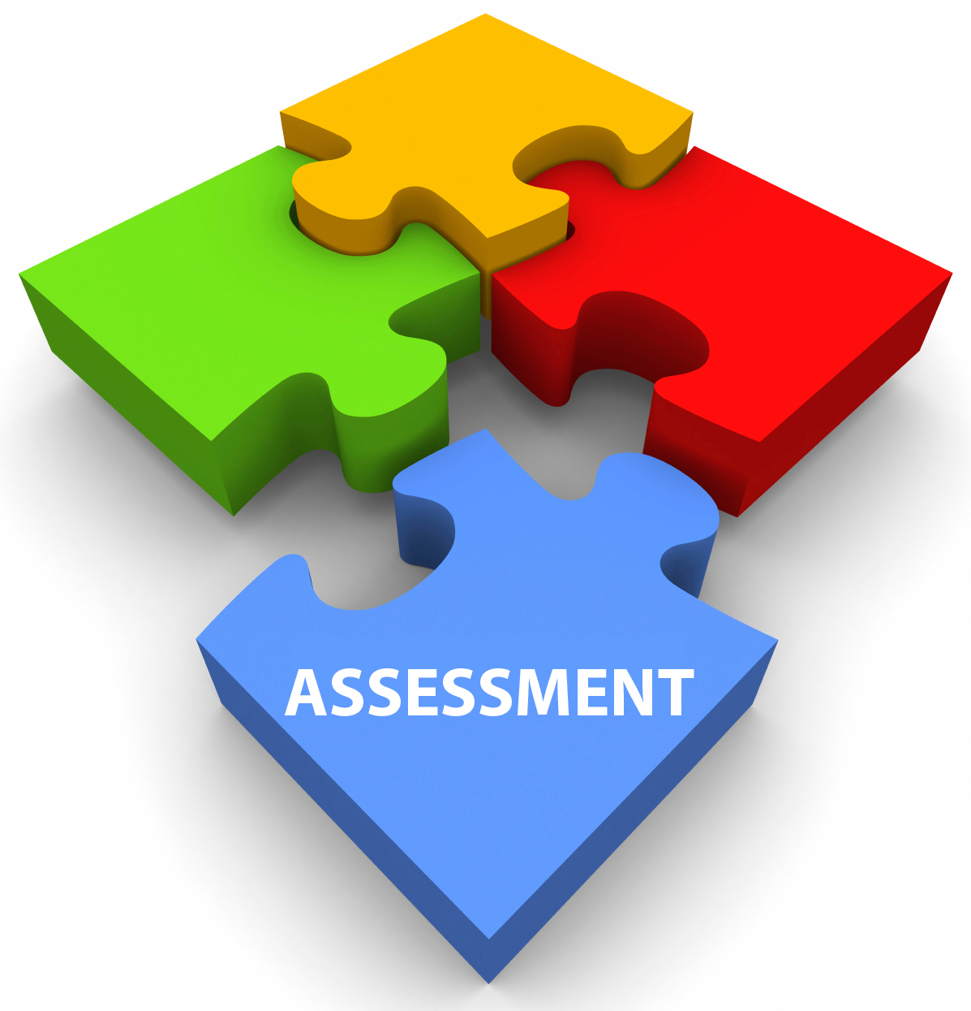
What does assessment mean to you?

Slide 5
“Assessment is broadly defined in the Principles as the process of collecting and interpreting information that can be used (i) to inform students, and their parents/guardians where applicable, about the progress they are making toward attaining the knowledge, skills, attitudes, and behaviors to be learned or acquired, and (ii) to inform the various personnel who make educational decisions (instructional, diagnostic, placement, promotion, graduation, curriculum planning, program development, policy) about students”.
Joint Advisory Committee. Principle for Fair Student Assessment Practices for Education in Canada. Edmonton, Alberta. 1993.

Slide 6
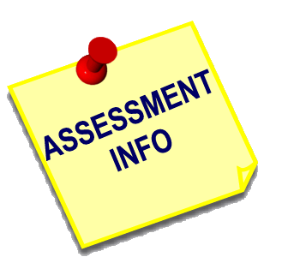
Before Assessment
It is important to understand and establish:
student identity
student needs
purpose of assessment
how we are assessing

Slide 7
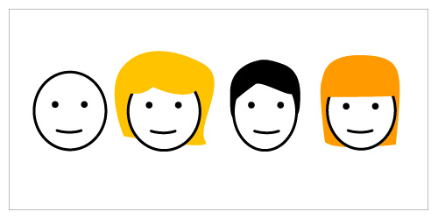
Student Identity
Culture
Religion
Background
Interests
L1 literacy

Slide 8

Student Needs
Special considerations
Preferred modes of learning
Preferred means of assessment

Slide 9
Woodcock- Munoz Language Survey Revised (WMLS-R)
7 Areas of Evaluation:
Picture Vocabulary
Verbal Analogies
Letter-Word Identification
Dictation
Understanding Directions
Story Recall
Passage Comprehension

Slide 10
WMLS-R Continued..
Uses of the Survey:
assess the level of language proficiency
measure CALP
lesson planning
monitoring student progress
evaluate program
http://www.assess.nelson.com/test-ind/wmls-r.html

Slide 11
Purposes of Assessment
Do I want to….
inform instructional planning?
place a student based on ability?
further develop my program?
evaluate the effectiveness of my program?

Slide 12
How to Assess
Use a wide range of authentic tasks, tools, and techniques.
rich tasks
multiple response options
checklists
rating scales
portfolios
comprehensive rubrics

Slide 13
How to Use Assessment
assess both strengths and weaknesses of the student
informational, dynamic tool
provide meaningful feedback
formative rather than summative

Slide 14
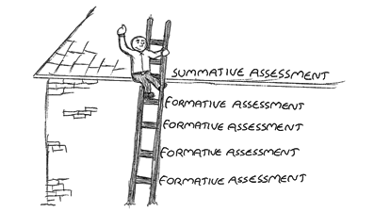
Summative vs. Formative
standardized
convergent
static
assessment of learning
informational
divergent
dynamic
assessment for learning

Slide 15
Key Principles
Assessment activities should help teachers make instructional decisions.
Assessment strategies should help teachers find out what students know and can do...not what they cannot do.
The holistic context for learning should be considered and assessed.

Slide 16
Key Principles Cont.
4. Assessment activities should grow out of authentic learning activities.
Best assessments of student learning are
longitudinal...they take place over time.
Each assessment activity should have a specific
objective-linked purpose. (pp. 91–92)
Lenski, S. D., Ehlers-Zavala, F., Daniel, M. C., & Sun-Irminger, X. (2006). Assessing English-Language Learners in Mainstream Classrooms. Reading Teacher, 60(1), 24-34.

Slide 17
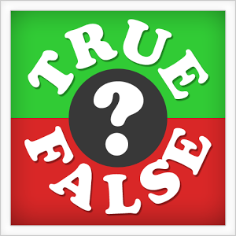
True or False
It is important to understand the cultural background of the students that you are assessing.
Summative assessments are more beneficial to ELLs.
Assessments are used to find out what a student cannot do.
Assessments should be used for a specific purpose.
Assessment is the collection and interpretation of student information.

Slide 18
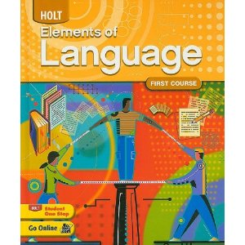
The four main elements of Language are:
Listening
Speaking
Reading
Writing
Notes:
Mariyah: We will primarily focus on the use of formative assessments in the classroom, highlighting the four main elements of language- listening, speaking, writing, and reading. Listening comprehension precedes speaking, reading, and writing fluency (Krashen, 1983).

Slide 19
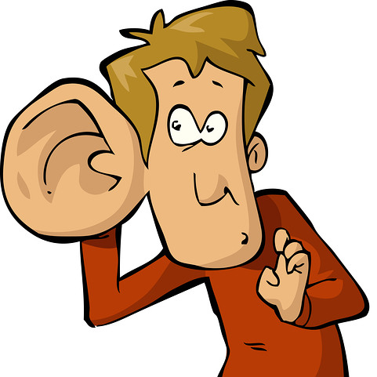
Interaction!
Type in what you think is a strategy for a formative assessment for the element of listening?

Slide 20

Formative Assessment Strategies for Listening
Example: Listening to Recorded texts
Assessment for any kind of listening task:
Listening Log
Self- Assessment Form
Notes:
Mariyah: The task is designed for students to focus their attention on the main idea, key and supporting details while students listen to a recorded text. The teacher can prepare a variety of different short recordings - part of a book their reading in guided reading, a song, the news or a description of an event on the radio.

Slide 21
Formative Assessment Strategies for Listening
Self- Assessment Form
Students reflect on their listening strategies before and after each task
Notes:
Mariyah: Self- Assessment Form: Students reflect on their listening strategies before and after each task.

Slide 22
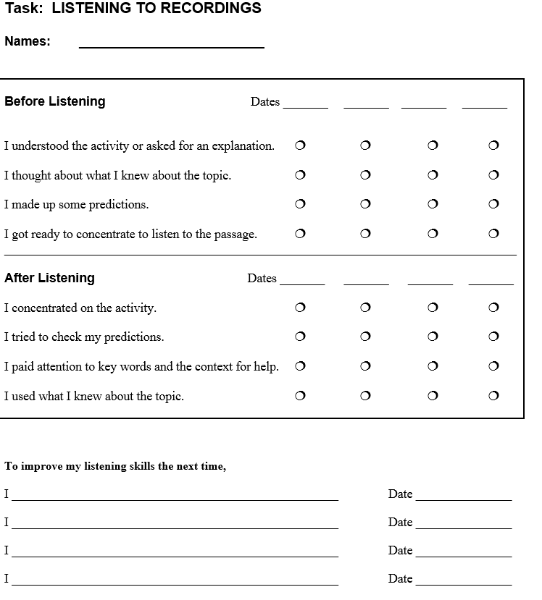
Self- Assessment Form
Notes:
Mariyah: Self- Assessment Form: Students reflect on their listening strategies before and after each task.
http://forum.quoteland.com/eve/forums/a/tpc/f/99191541/m/4301937495

Slide 23
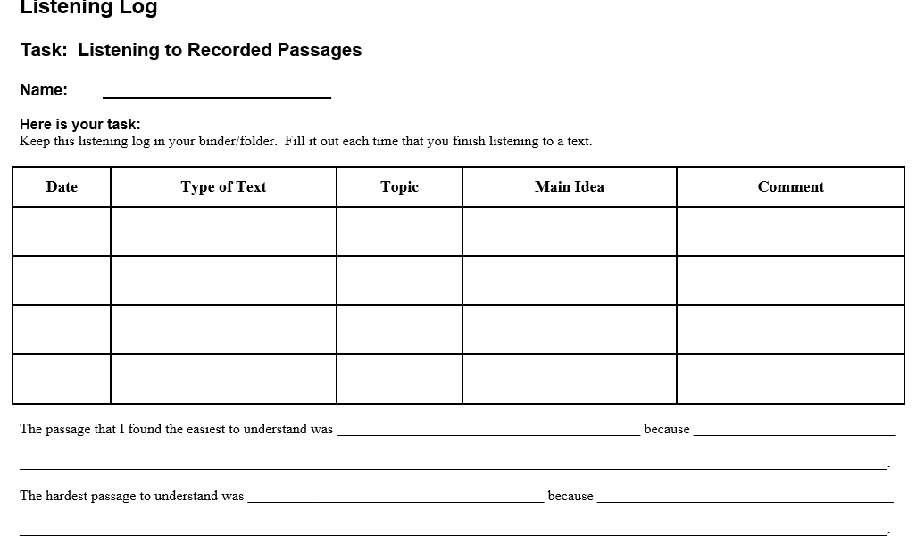
Listening Log
Notes:
Mariyah: Students record the type of text they listen to, the topic, main idea, key and supporting information, and a brief comment.
http://forum.quoteland.com/eve/forums/a/tpc/f/99191541/m/4301937495

Slide 24

Interaction!
Type in what you think is a strategy for a formative assessment for the element of speaking?

Slide 25
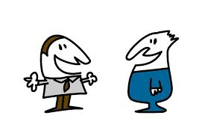
Formative Assessment Strategies for Speaking
Spontaneous Speaking Assessments
Example: Give Images to students
Notes:
Mariyah: Give students images and have them speak to you in English. See if the sentences are meaningful, appropriate and comprehensible. Keep in mind, you have given plenty of examples before of what is meaningful, appropriate and comprehensible.
Once the students complete the formative assessments, give them immediate feedback so they do not have to wait until the unit exam or until mid semester where they need to improve in their speaking.

Slide 26
Formative Assessment Strategies for Speaking
Alternate way:
Have students in pairs with the images
Notes:
Mariyah:
Partner up the students in pairs and give them two images. One partner talks about the image in English for one minute while her partner, counts the number of sentences she says that are meaningful and appropriate, comprehensible. Students then reverse roles. The teacher can walk around listening and have a checklist for this. Since the listening partners are not thinking about what they will say next in the conversation, they can focus carefully on the speakers’ sentences.

Slide 27
Formative Assessment Strategies for Speaking
Alternate way:
Have students in pairs with the images
Benefits:
socializing
providing and acquiring information
expressing personal feelings and opinions
getting others to adopt a course of action
Notes:
Mariyah:
Even though this activity is designed for partners, a back and forth conversation is not the goal at this point. the teahcer has the students speak individually on the image/topic so their partners do not limit their practice opportunity. therefore, although students work with a partner, only one student speaks during each part of the oral assessment.

Slide 28
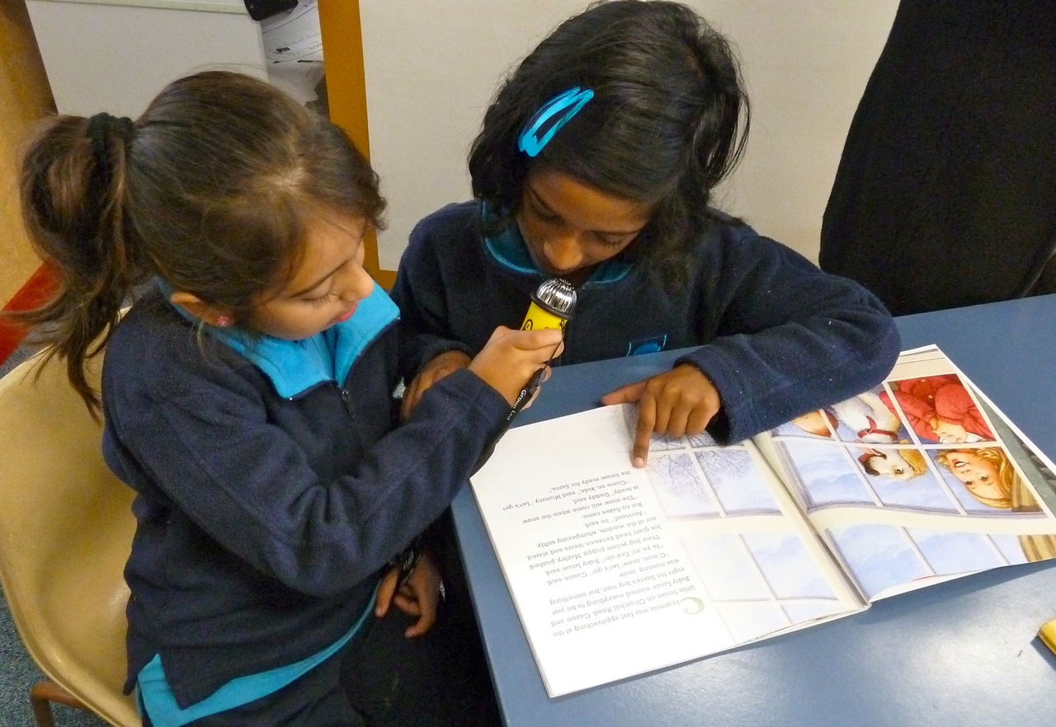
Formative Assessment Strategies for Speaking
Planned Speaking Assessments
Here, they receive a topic and a function, plan out what they want to say and practice before the assessment.
Example: Describe what they use to do to celebrate their birthday at age 5
Notes:
Students record their voice. then Other students listen to this recorded speech and give feedback to the speakers.
The students can even record their speaking for any unit in Language Arts. Towards the end of the course, they go back and listen to themselves to hear how much more fluent they have become. The teacher can use this as a formative assessment as she/he can see the progress.

Slide 29

Formative Assessment Strategies for Speaking
Huge Benefit:
Using recorded speech, this formative assessment not only provides valuable information to teachers, but to students.
Notes:
Mariyah:
While the students are also involved in more formal assessments, there can be a great benefit to daily formative assessments which not only provide valuable information to teachers, but also engage students directly in their own monitoring and reflection on their learning.

Slide 30

Interaction!
Type in what you think is a strategy for a formative assessment for the element of reading?

Slide 31

Formative Assessment Strategies for Reading
Before assessing be sure to…
Offer many opportunities for students to read
Model good reading
Focus on comprehension in reading

Slide 32

Formative Assessment Strategies for Reading
Participation during read alouds
Matching Activities
Guided Reading
Online Quizzes

Slide 33
Formative Assessment Strategies for Reading
Participation During Read Alouds
While reading to students ask comprehension questions to either the whole class or to them as individuals.
Monitor participation and accuracy of answers during this time.
Notes:
Tasha- Be sure to ask questions pertaining to comprehension but also about vocabulary words. ex. “what does ‘exhausted’ mean? Can anyone explain? Can anyone act out what they are like when they are exhausted?”
http://iteslj.org/Techniques/Bazo-FourSkills.html

Slide 34
Formative Assessment Strategies for Reading
The Benefits of Read Aloud Participation
Allows teachers to focus in on a students ability to comprehend the reading and thus allows them to decide if readings need to be adjusted to their comprehension level.

Slide 35

Formative Assessment Strategies for Reading
Matching Activities
Have a student match pictures to written words
Notes:
Using pictures and written words have students either individually with you helping or with a partner use the pictures and try to match it to the words.

Slide 36
Formative Assessment Strategies for Reading
The Benefits of Matching Activities
This provides a hands on activity that enables students who learn more kinesthetically but it also allows teachers to assess the students ability to recognize key concepts and vocabulary.

Slide 37
Formative Assessment Strategies for Reading
Guided Reading
Either one on one or with multiple students of similar reading level
Pick a book the student(s) can read with high accuracy
During the reading use a formal running record
Notes:
Similar to read alouds, check to see students understanding of concepts and vocabulary. If students don’t know the concepts or vocabulary be sure to explain it and revisit it. http://iteslj.org/Techniques/Yun-DefiningWords.html

Slide 38
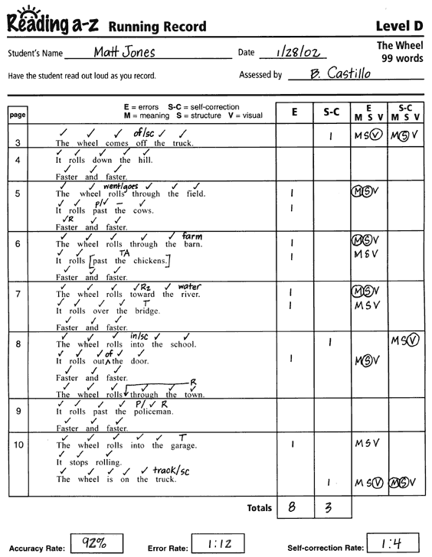
Formal Running Record

Slide 39
Formative Assessment Strategies for Reading
A Note About Guided Reading:
Depending upon the reading level, reading aloud may not be beneficial to students.
It is a good idea to use picture books where pictures illustrate the events of the story in order to aid comprehension.
Instead of having students read the text aloud have them read silently and then ask comprehension questions.

Slide 40
Formative Assessment Strategies for Reading
The Benefits of Guided Reading
By taking a running record it allows teachers to recognize where students struggle and what their reading level is.

Slide 41
Formative Assessment Strategies for Reading
Online Quizzes
a4esl.org has an online vocabulary quiz where students can match pictures to words.
There is also a variety of other quizzes available, even in two languages.
Lextutor.ca has recognition word tasks and quizzes.
Notes:
Note: if you choose to use these quizzes please keep in mind that students at this level are not yet ready to focus on grammar and mistakes. We are trying to focus on comprehension and meaning and not grammar mistakes.

Slide 42
Formative Assessment Strategies for Reading
Benefits of Online Quizzes
Allows students to be assessed in a way that may be less intimidating than a pen and paper task.
By looking at the results teachers can easily recognize the level of readers their students are.

Slide 43
Interaction!
Type in what you think is a strategy for a formative assessment for the element of writing?

Slide 44
Formative Assessment Strategies for Writing
Before assessing be sure to…
Focus on meaning of writing as well as comprehension instead of errors in writing
Do not use criteria that is based on native English speakers
Model good writing
Monitor a student’s progress
Provide Encouragement

Slide 45
Formative Assessment Strategies for Writing
Checklists to Observe Beginning Writing
Writing Journals
Interactive Writing

Slide 46
Formative Assessment Strategies for Writing
Checklists to Observe Beginning Writing
While students are doing any type of writing activity walk to observe and record what they are writing vs. the words they are trying to convey.
Offer prompts to help students finish or correct the words.
Record the end result.

Slide 47
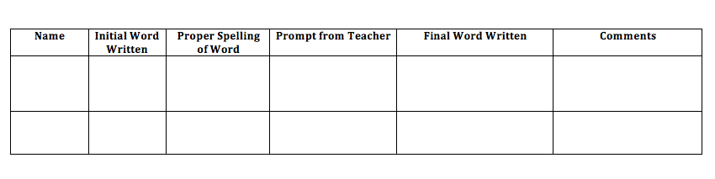
Beginner Writer Checklist
Notes:
There are a variety of beginner writing checklist, this one looks at the words written, what the real word should be, the prompt from the teacher, the final word written/corrected and comments from the teacher.

Slide 48
Formative Assessment Strategies for Writing
The Benefits of Checklists
Checklists allows teachers to observe the writing abilities of students, what they struggle with, and if they are able to correct it using the prompts of the teacher.

Slide 49
Formative Assessment Strategies for Writing
Writing Journals
Write in journals daily as a class
Provide meaningful topics
Respond to students journal entries
Can be used as a form of portfolio
Notes:
Making writing journals more interesting by making them into a portfolio, this can be as simple as creating a duotang with blank paper in it, having a student create a cover page and writing goals on the page after. As the year goes on students can write in the journal daily and look back at where they started in order to monitor their own progress. As student’s ability grows you can easily change and update goals.
https://education.alberta.ca/media/507659/eslkto9gi.pdf

Slide 50
Formative Assessment Strategies for Writing
The Benefits of Writing Journals
Writing journals not only give students practice but it also gives teachers and students a chance to monitor their progress.

Slide 51
Formative Assessment Strategies for Writing
Interactive Writing
Provide topics for students to write about, base it off of personal experiences, media, ect.
Talk over the topic with student(s) and have them come up with a story/problem.
Scribe for students.
Depending upon writing level have them write out the first letter of a word, a whole word, and so on.
Notes:
If possible, have students write the story in their own language and if there is a bilingual teacher/aid they can help you assess their writing abilities.
This can be done with an individual or a few students who are at similar writing level

Slide 52
Formative Assessment Strategies for Writing
The Benefits of Interactive Writing
·
This not only allows student to work on their creative writing skills and make connections to topics but it also gives the teacher a chance to identify trouble words and errors students are making.

Slide 53
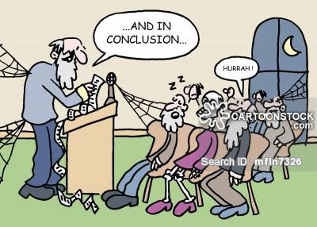

Slide 54
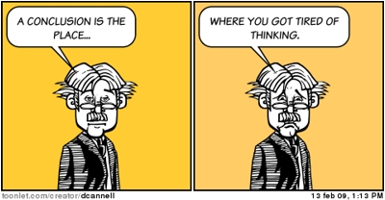
Conclusion
Before you assess know your learner, and what you want to achieve through assessment
Assessment should be formative, rather than summative.
Authentic, open ended assessments hold the most benefit for the ELL student.
There are many tools to assess the 4 areas of language: listening, speaking, reading, and writing.

Slide 55
References
Alberta Education. (2007). English as a Second Language: Guide to Implementation. Retrieved from: https://education.alberta.ca/media/507659/eslkto9gi.pdf
Coelho, E. (2001). Program Planning and Assessment for ESL/ELD Learners. Toronto District School Board. Retrieved from: https://eclass.srv.ualberta.ca/pluginfile.php/1888847/mod_resource/content/2/Day5_Article1.pdf
Cabrera, M.P. (2002). Teaching the Four Skills in the Primary EFL Classroom. The Internet TESL Journal. Retrieved from: http://iteslj.org/Techniques/Bazo-FourSkills.html
Herrell, A., & Jordan, M. (2012). 50 strategies for teaching English language learners (4th ed.). Upper Saddle River, NJ: Pearson/ Merrill Prentice Hall.
http://forum.quoteland.com/eve/forums/a/tpc/f/99191541/m/4301937495
http://www.nysut.org/~/media/files/nysut/resources/2012/may/educators-voice-5-assessments/edvoicev_07_daily_assessment_esl.pdf?la=en
http://www.assess.nelson.com/test-ind/wmls-r.html
Joint Advisory Committee. Principle for Fair Student Assessment Practices for Education in Canada. Edmonton, Alberta. 1993.
Lenski, S. D., Ehlers-Zavala, F., Daniel, M. C., & Sun-Irminger, X. (2006). Assessing English-Language Learners in Mainstream Classrooms. Reading Teacher, 60(1), 24-34.
Yun, J., Cervantes, M. (2006). Defining Words: What Can Teachers and Students Do? The Internet TESL Journal. Retrieved from: http://iteslj.org/Techniques/Yun-DefiningWords.html

